Slide 1
Rosette formation
Cell mechanics parameter sweep
Full results for the parameter study on the role of cell mechancis parameters (namely the adhesion and repulsion coefficients for cell-cell, cell-neurite and neurite-neurite interactions).
Table of contents:
Rosette type classification criteria and examples............................................................................... ................................................ .........................................2
Results for low repulsion between neurites............................................................................... ...................................................... ..................................3
Results for balanced adhesion and repulsion between neurites......................................... ................ ........................................................................ 6
<
Results for high repulsion between neurites .......................... .. ................ ............................................... ........................... 9
Summarized results for all interaction combinations............................................... ...................................................................................12

Slide 2
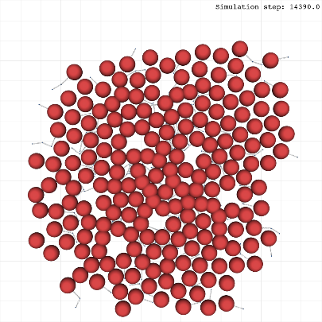
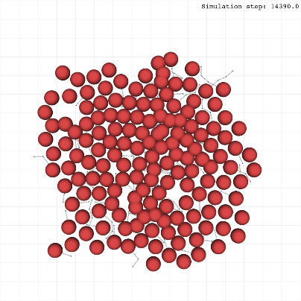
Well-defined Homer-Wright rosettes
Marked as green circles
- At least one neurite inside
and
- Circular structure
and/or
- Contour cells attached to each other
Poorly-defined Homer-Wright rosettes
Marked as yellow circles
- At least one neurite inside
and
- Compromised circular structure
and/or
- Contour cells not attached
True ependymal rosettes
Marked as gray circles
- No neurites inside
and
- Circular structure
and/or
- Contour cells attached to each other
Neurocyticrosettes
Marked as blue ellipses
- At least one neurite inside
and
- Large and elongated structure
and/or
- Contour cells attached to each other
2

Slide 3

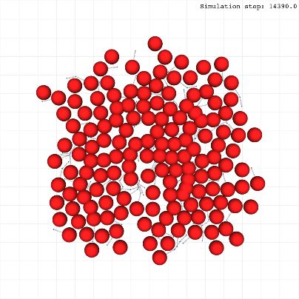
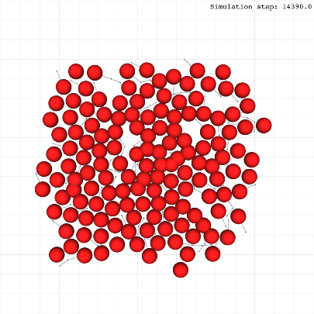

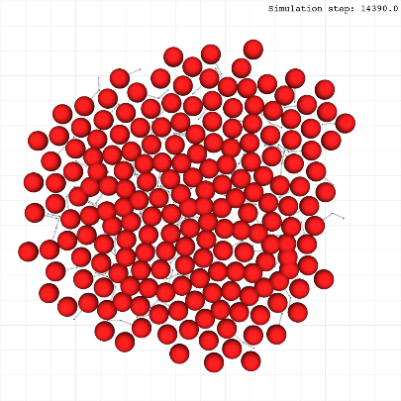
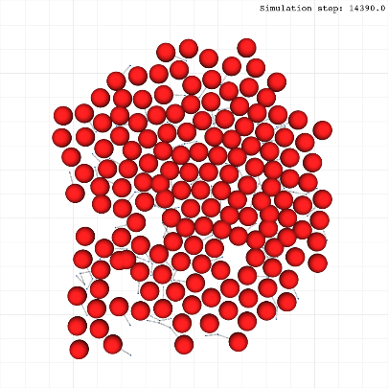
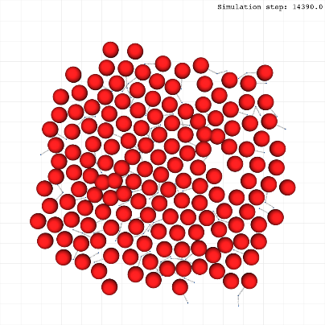
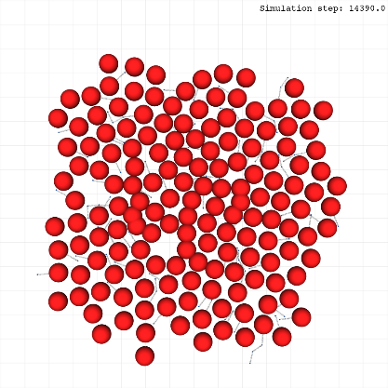
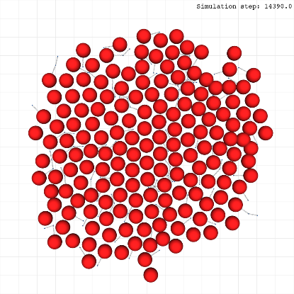
Replicate 1
Replicate 2
Replicate 3
Rosette formation
Cell mechanics parameter sweep
Low cell-cell repulsion
(cca=5.0, ccr=15.0)
Neurite-neurite interactions:
Low repulsion
Adhesion coefficient: 5.0
Repulsion coefficient: 15.0
Neurite-cell interactions:
Low repulsion
Adhesion coefficient: 5.0
Repulsion coefficient: 15.0
Cell-cell interactions:
Variable
See row label for each case
Balanced cell-cell adhesion/repulsion
(cca=5.0, ccr=25.0)
High cell-cell repulsion
(cca=5.0, ccr=50.0)
3
Notes:
3

Slide 4
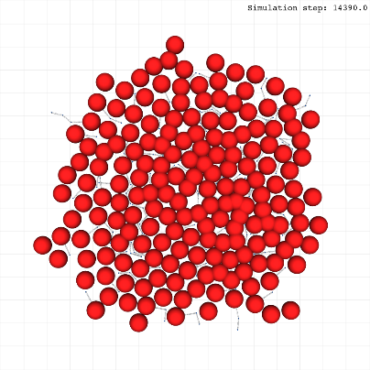
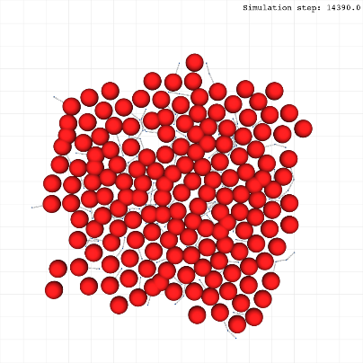
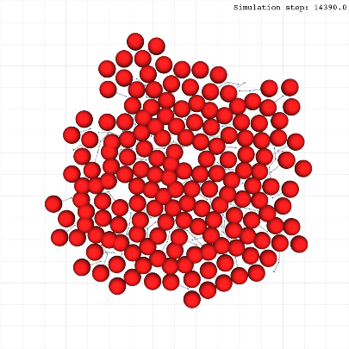
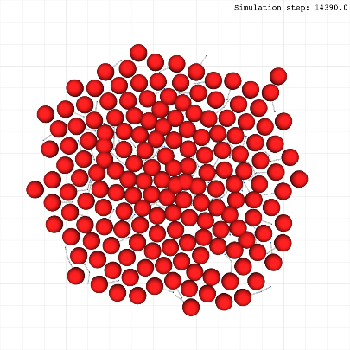
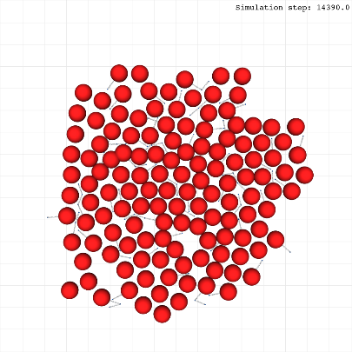
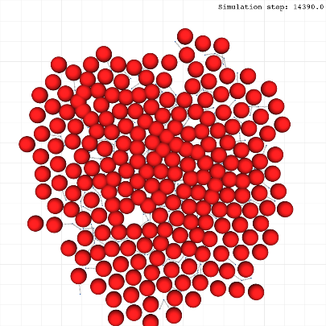
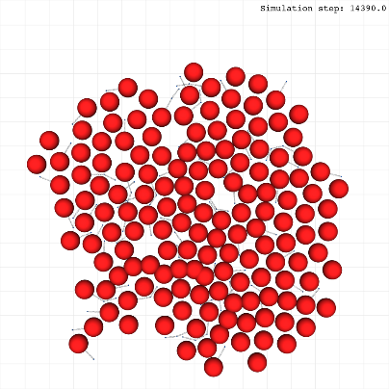
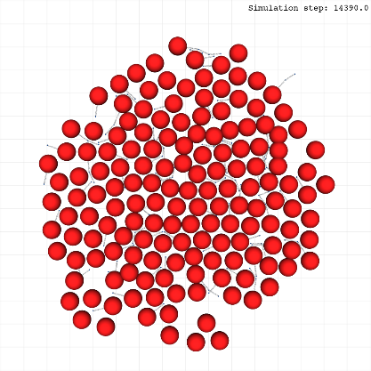
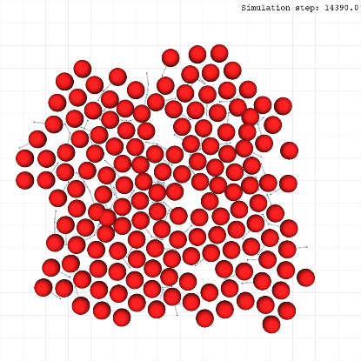
Replicate 1
Replicate 2
Replicate 3
Rosette formation
Cell mechanics parameter sweep
Low cell-cell repulsion
(cca=5.0, ccr=15.0)
Neurite-neurite interactions:
Low repulsion
Adhesion coefficient: 5.0
Repulsion coefficient: 15.0
Neurite-cell interactions:
Balanced repulsion
Adhesion coefficient: 5.0
Repulsion coefficient: 25.0
Cell-cell interactions:
Variable
See row label for each case
<
Balanced cell-cell adhesion/repulsion
(cca=5.0, ccr=25.0)
High cell-cell repulsion
(cca=5.0, ccr=50.0)
4

Slide 5
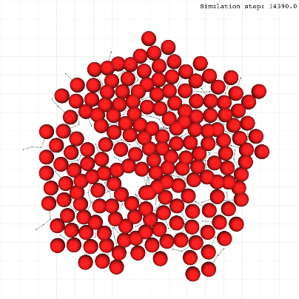
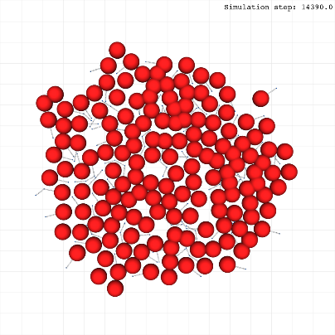
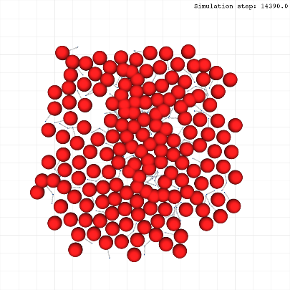
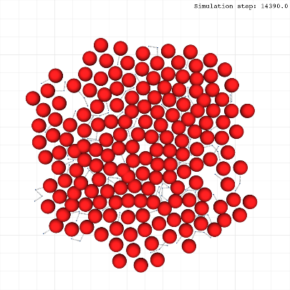
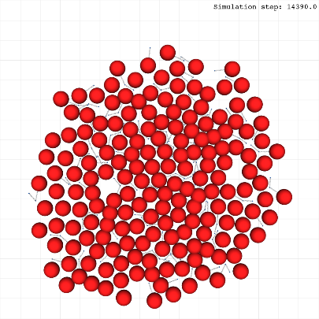
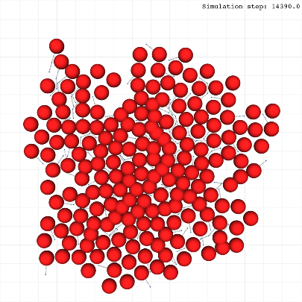
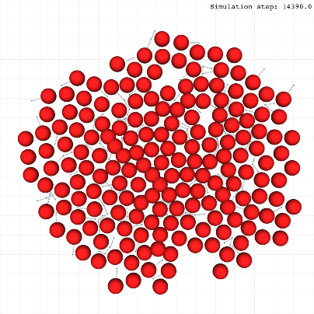
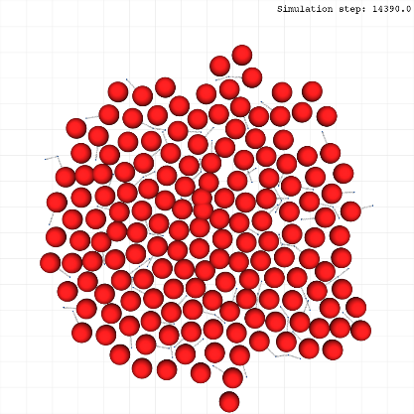
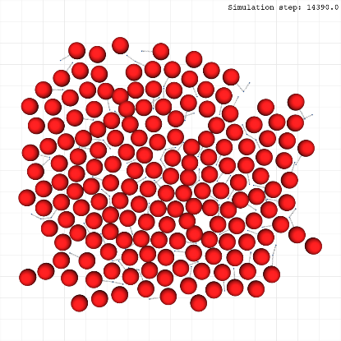
Replicate 1
Replicate 2
Replicate 3
Rosette formation
Cell mechanics parameter sweep
Low cell-cell repulsion
(cca=5.0, ccr=15.0)
Neurite-neurite interactions:
Low repulsion
Adhesion coefficient: 5.0
Repulsion coefficient: 15.0
Neurite-cell interactions:
High repulsion
Adhesion coefficient: 5.0
Repulsion coefficient: 50.0
Cell-cell interactions:
Variable
See row label for each case
Balanced cell-cell adhesion/repulsion
(cca=5.0, ccr=25.0)
High cell-cell repulsion
(cca=5.0, ccr=50.0)
5
Notes:
5

Slide 6
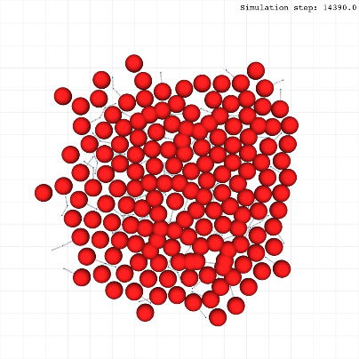
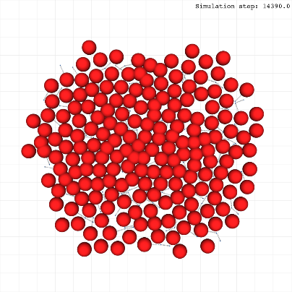
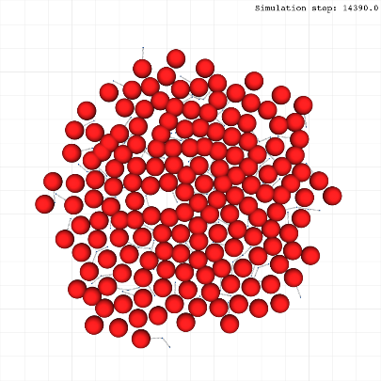
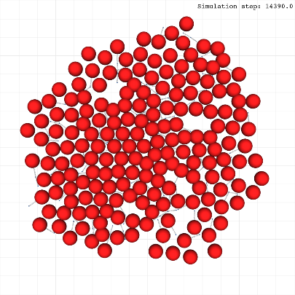
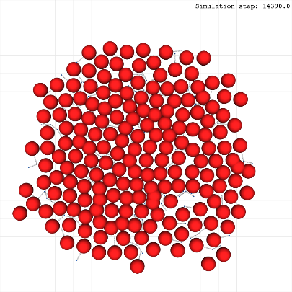
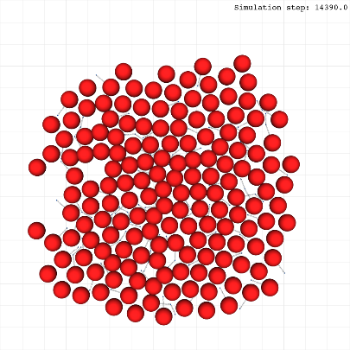
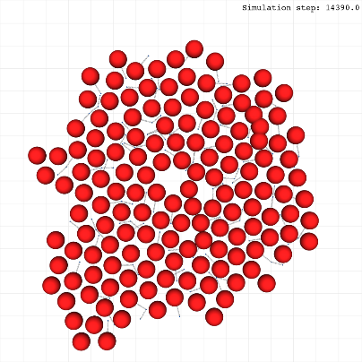
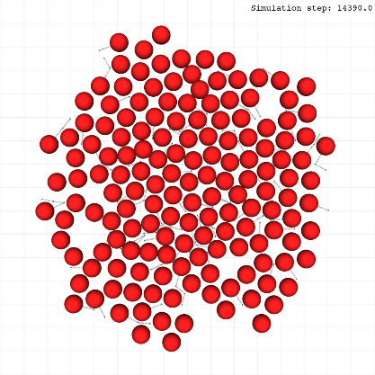
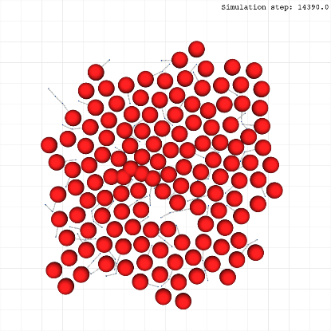
Replicate 1
Replicate 2
Replicate 3
Rosette formation
Cell mechanics parameter sweep
Low cell-cell repulsion
(cca=5.0, ccr=15.0)
Neurite-neurite interactions:
Balanced repulsion
Adhesion coefficient: 5.0
Repulsion coefficient: 25.0
Neurite-cell interactions:
Low repulsion
Adhesion coefficient: 5.0
Repulsion coefficient: 15.0
Cell-cell interactions:
Variable
See row label for each case
Balanced cell-cell adhesion/repulsion
(cca=5.0, ccr=25.0)
High cell-cell repulsion
(cca=5.0, ccr=50.0)
6
Notes:
6

Slide 7
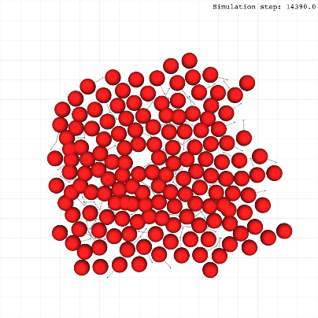
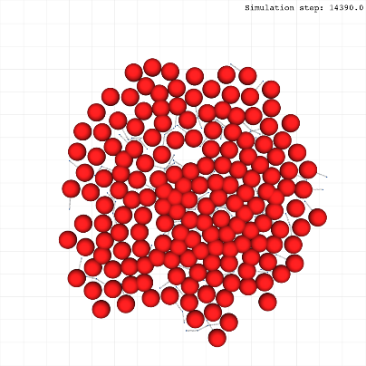
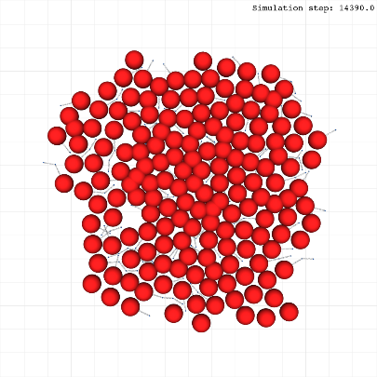
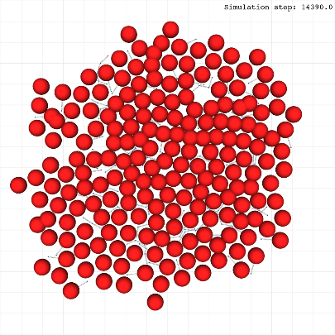
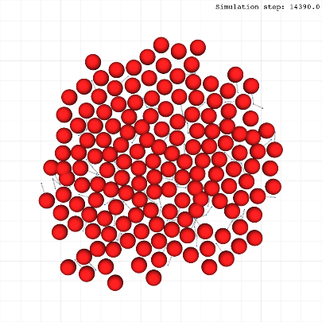
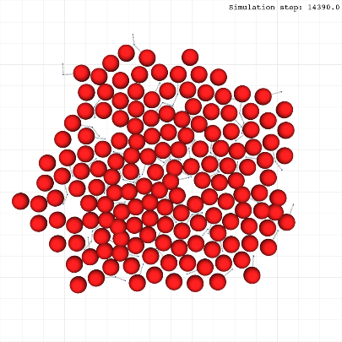
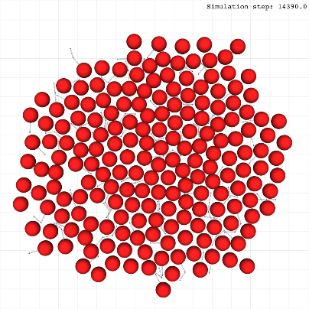
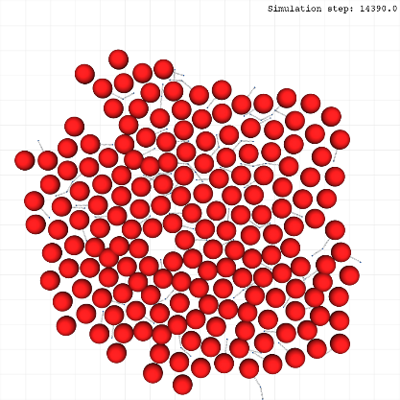
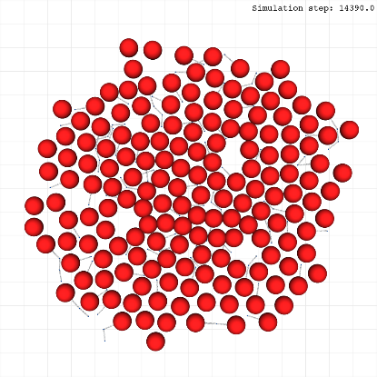
Replicate 1
Replicate 2
Replicate 3
Rosette formation
Cell mechanics parameter sweep
Low cell-cell repulsion
(cca=5.0, ccr=15.0)
Neurite-neurite interactions:
Balanced repulsion
Adhesion coefficient: 5.0
Repulsion coefficient: 25.0
Neurite-cell interactions:
Balanced repulsion
Adhesion coefficient: 5.0
Repulsion coefficient: 25.0
Cell-cell interactions:
Variable
See row label for each case
Balanced cell-cell adhesion/repulsion
(cca=5.0, ccr=25.0)
High cell-cell repulsion
(cca=5.0, ccr=50.0)
7
Notes:
7

Slide 8
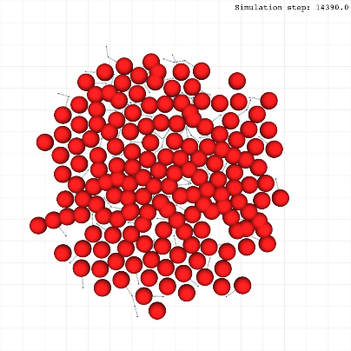
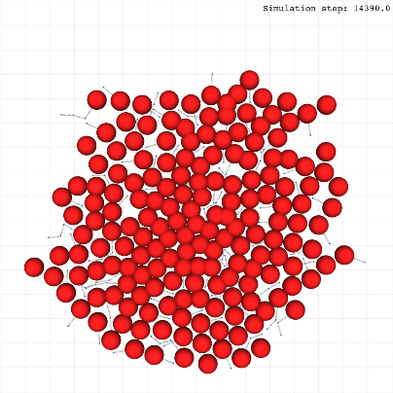
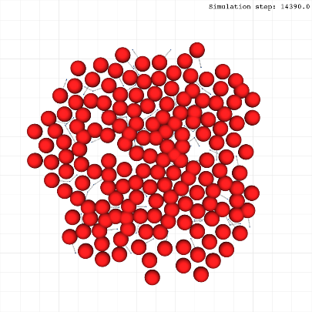
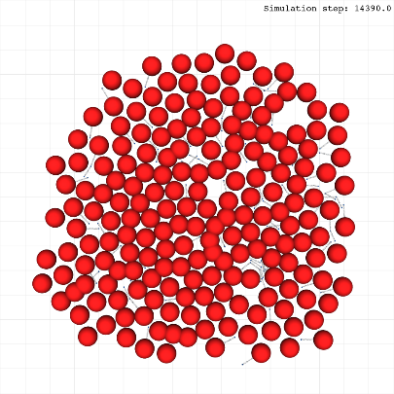
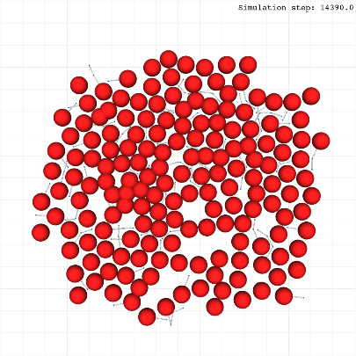




Replicate 1
Replicate 2
Replicate 3
Rosette formation
Cell mechanics parameter sweep
Low cell-cell repulsion
(cca=5.0, ccr=15.0)
Neurite-neurite interactions:
Balanced repulsion
Adhesion coefficient: 5.0
Repulsion coefficient: 25.0
Neurite-cell interactions:
High repulsion
Adhesion coefficient: 5.0
Repulsion coefficient: 50.0
Cell-cell interactions:
Variable
See row label for each case
Balanced cell-cell adhesion/repulsion
(cca=5.0, ccr=25.0)
High cell-cell repulsion
(cca=5.0, ccr=50.0)
8
Notes:
8

Slide 9









Replicate 1
Replicate 2
Replicate 3
Rosette formation
Cell mechanics parameter sweep
Low cell-cell repulsion
(cca=5.0, ccr=15.0)
Neurite-neurite interactions:
High repulsion
Adhesion coefficient: 5.0
Repulsion coefficient: 50.0
Neurite-cell interactions:
Low repulsion
Adhesion coefficient: 5.0
Repulsion coefficient: 15.0
Cell-cell interactions:
Variable
See row label for each case
Balanced cell-cell adhesion/repulsion
(cca=5.0, ccr=25.0)
High cell-cell repulsion
(cca=5.0, ccr=50.0)
9
Notes:
9

Slide 10









Replicate 1
Replicate 2
Replicate 3
Rosette formation
Cell mechanics parameter sweep
Low cell-cell repulsion
(cca=5.0, ccr=15.0)
Neurite-neurite interactions:
High repulsion
Adhesion coefficient: 5.0
Repulsion coefficient: 50.0
Neurite-cell interactions:
Balanced repulsion
Adhesion coefficient: 5.0
Repulsion coefficient: 25.0
Cell-cell interactions:
Variable
See row label for each case
Balanced cell-cell adhesion/repulsion
(cca=5.0, ccr=25.0)
High cell-cell repulsion
(cca=5.0, ccr=50.0)
10
Notes:
10

Slide 11









Replicate 1
Replicate 2
Replicate 3
Rosette formation
Cell mechanics parameter sweep
Low cell-cell repulsion
(cca=5.0, ccr=15.0)
Neurite-neurite interactions:
High repulsion
Adhesion coefficient: 5.0
Repulsion coefficient: 50.0
Neurite-cell interactions:
High repulsion
Adhesion coefficient: 5.0
Repulsion coefficient: 50.0
Cell-cell interactions:
Variable
See row label for each case
Balanced cell-cell adhesion/repulsion
(cca=5.0, ccr=25.0)
High cell-cell repulsion
(cca=5.0, ccr=50.0)
11
Notes:
11

Slide 12



Rosette formation
Cell mechanics parameter sweep
Well-defined Homer-Wright rosettes
Poorly-defined Homer-Wright rosettes
True ependymal rosettes
Neurocytic rosettes
Summarized results for all the simulations.
Heatmaps represent the mean number of rosette subtypes observed in each simulation (counting with replicates).
Top row: Low neurite-neurite repulsion
Middle row: Balanced neurite-neurite repulsion
Bottom row: High neurite-neurite repulsion
Cell-cell interactions
Cell-cell interactions
Cell-cell interactions
Cell-neurite interactions
Cell-neurite interactions
Cell-neurite interactions
Cell-neurite interactions
12
Notes:
12

